Slide 1
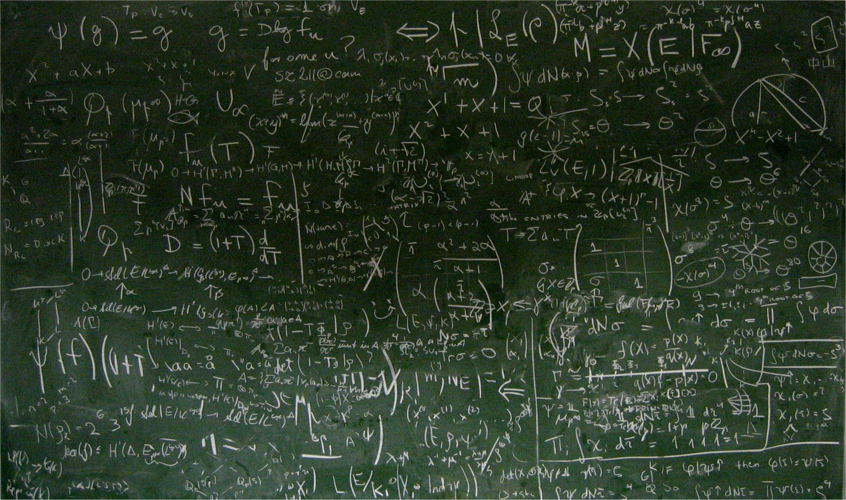
I Tried a Bunch of Things: The Dangers of Unexpected Overfitting in Classification
Michael Skocik, John Collins, Chloe Callahan-Flintoft, Howard Bowman, Brad Wyble

Slide 2
Overview
Overfitting as a concept
Addressing overfitting with cross-validation
How to make Cross-validation fail with real data
Historical Accounts of overfitting non-neuroscience ML
Alternatives to cross-validation to address identify estimate(?) overfitting

Slide 3

Overfitting
The optimization of a model on a given data set such that performance improves on the data being evaluated but remains constant or degrades on other similar data.

Slide 4
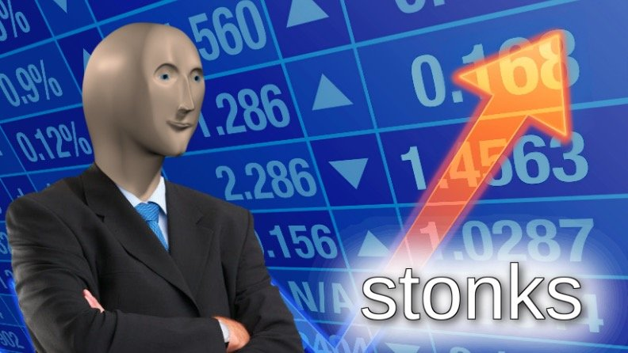
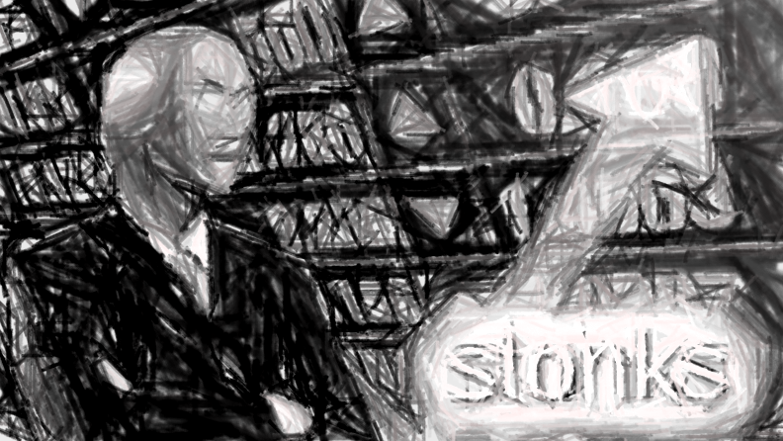
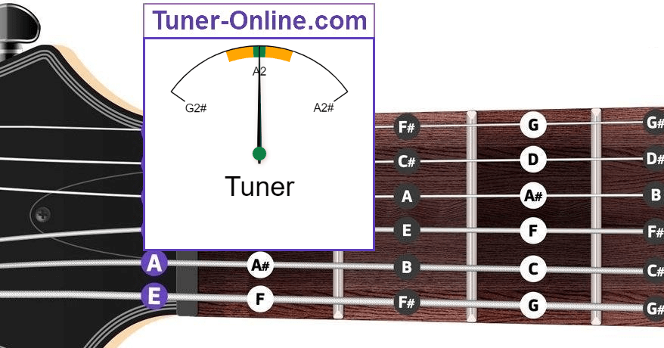
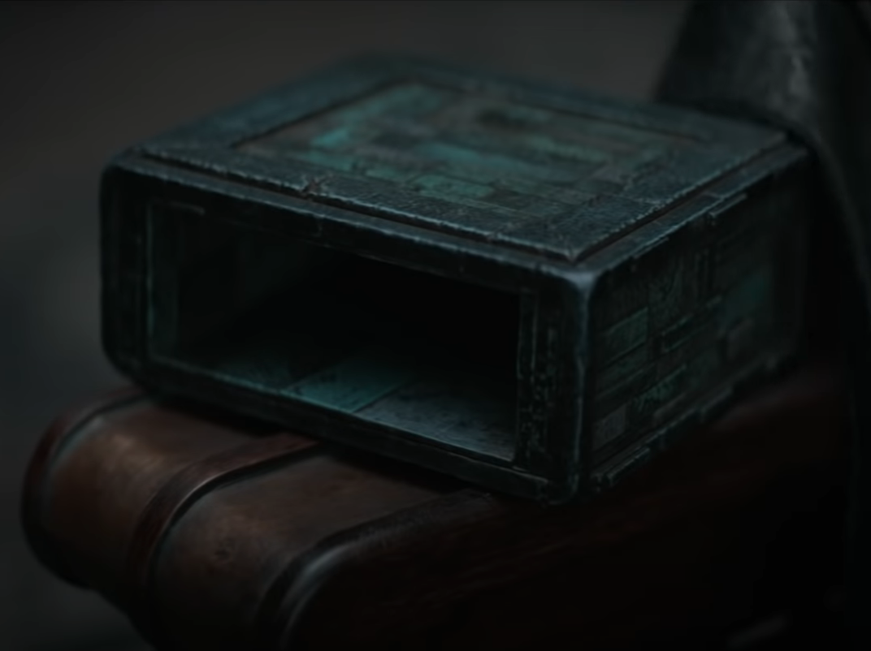
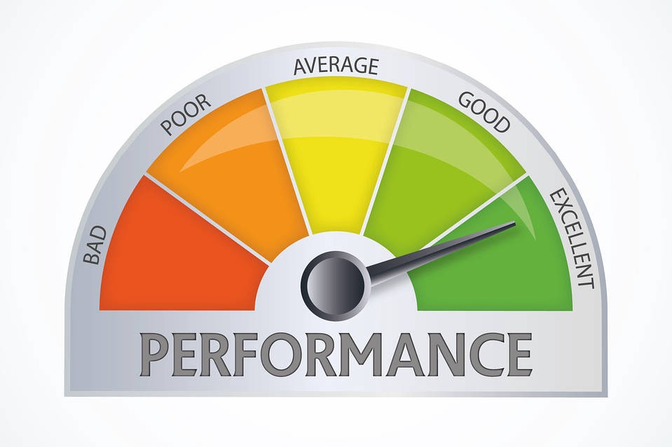
Preprocessing
Model
Parameter Tuning
Gom Jabbar
Training Parameters
Accuracy or similar metric

Slide 5
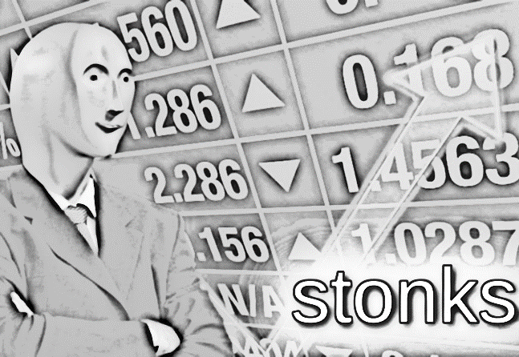
Preprocessing
Model
Parameter Tuning
Gom Jabbar
Training Parameters
Accuracy or similar metric

Slide 6

Feature Selection: artifact thresholds, channel/filter, voxel selection, feature weights
Preprocessing
Model
Parameter Tuning
Gom Jabbar
Training Parameters
Accuracy or similar metric

Slide 7
Feature Selection: artifact thresholds, channel/filter, voxel selection, feature weights
Preprocessing
Model
Feature Selection: artifact thresholds, channel/filter, voxel selection, feature weights
Parameter Tuning
Gom Jabbar
Training Parameters
Accuracy or similar metric

Slide 8
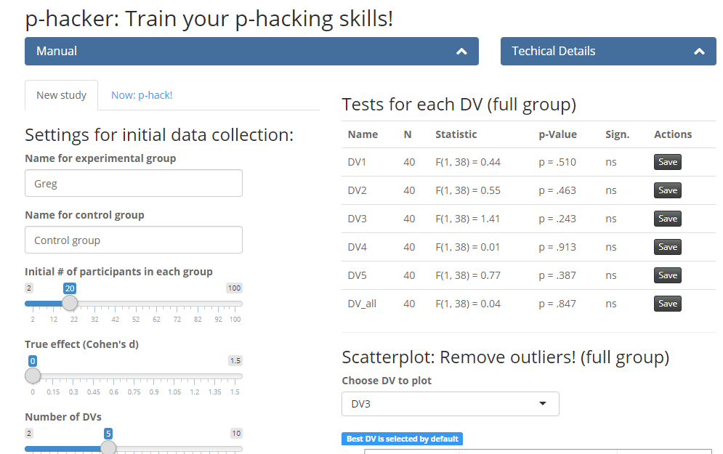
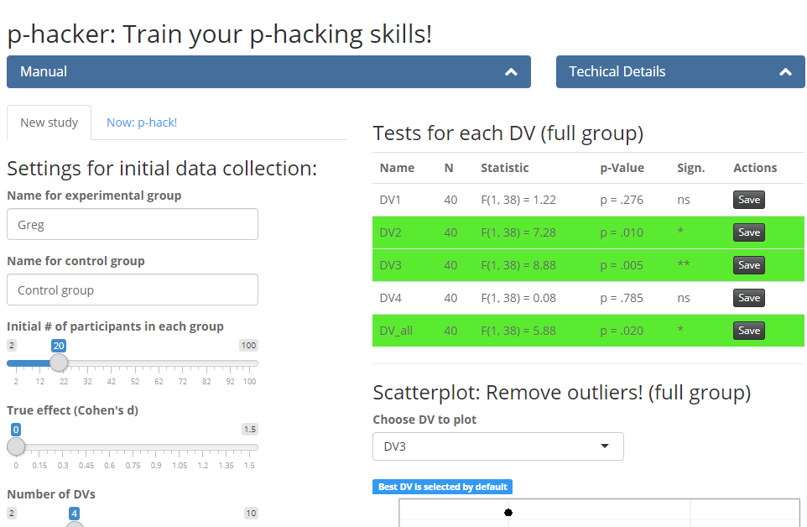
http://shinyapps.org/apps/p-hacker/

Slide 9
Approaches to test/minimize overfitting
Cross-validation (standard)
Lock-boxing
“Blind” analyses
Pre-registraiton

Slide 10
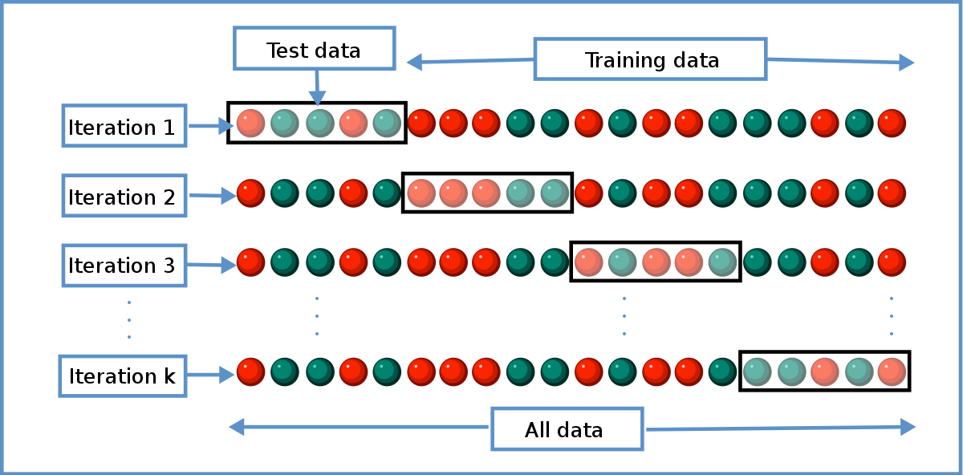
Addressing Overfitting(?): Cross-validation

Slide 11
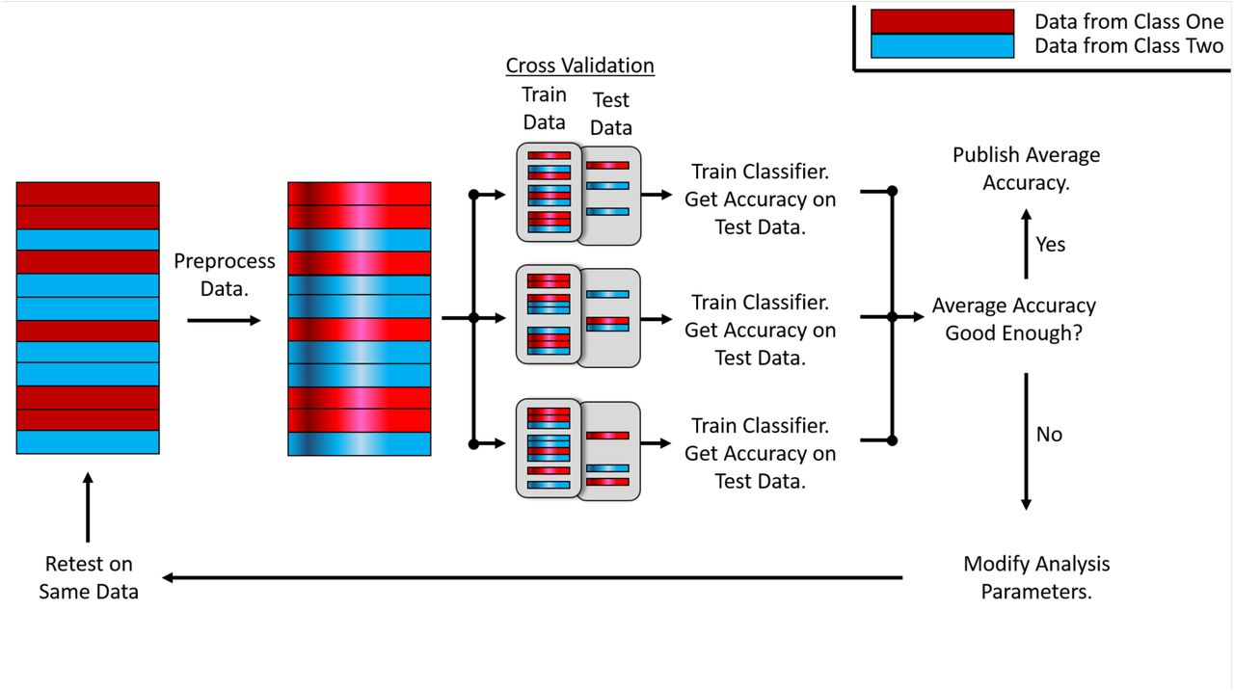

Slide 12
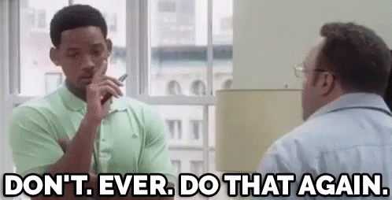
Cross-validation
The assumption:
After performing cross-validation, the analysis chain used to classify the data must not be modified to obtain higher performance on that same data.
Reusing the same data to optimize analysis parameters can induce overfitting, even if cross-validation is used at each iteration.

Slide 13
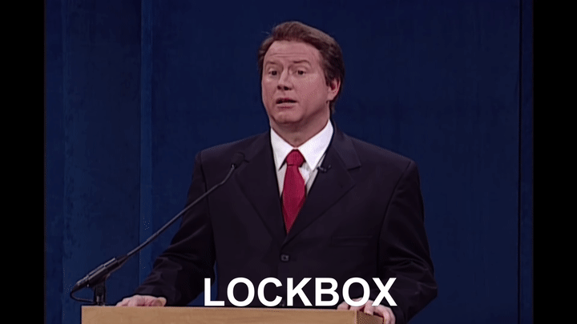
The Lockbox approach
Lock box - a set of data that is held-out from the optimization process for verification and should not be consulted until the methods have been completely determined.
AKA every Kaggle competition and things like it today.

Slide 14
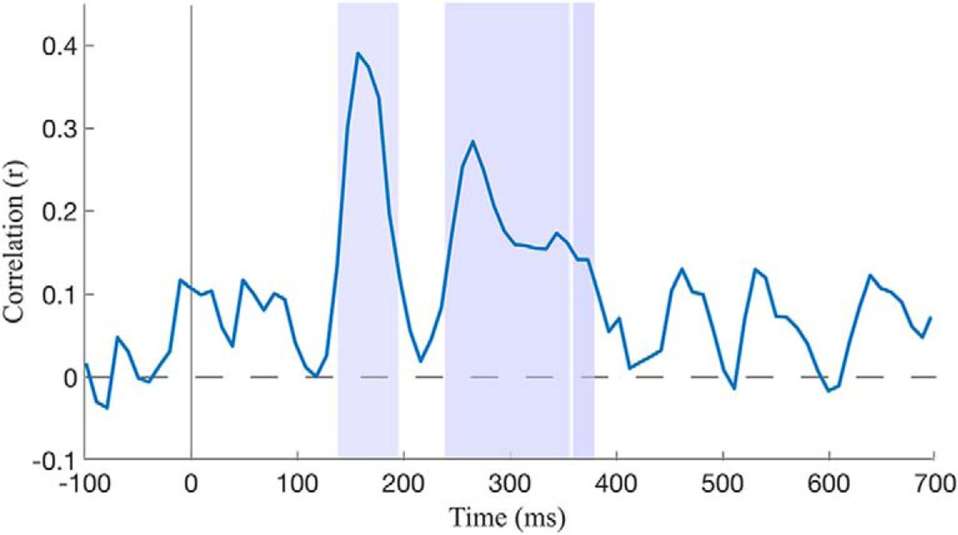
3
7

Slide 15
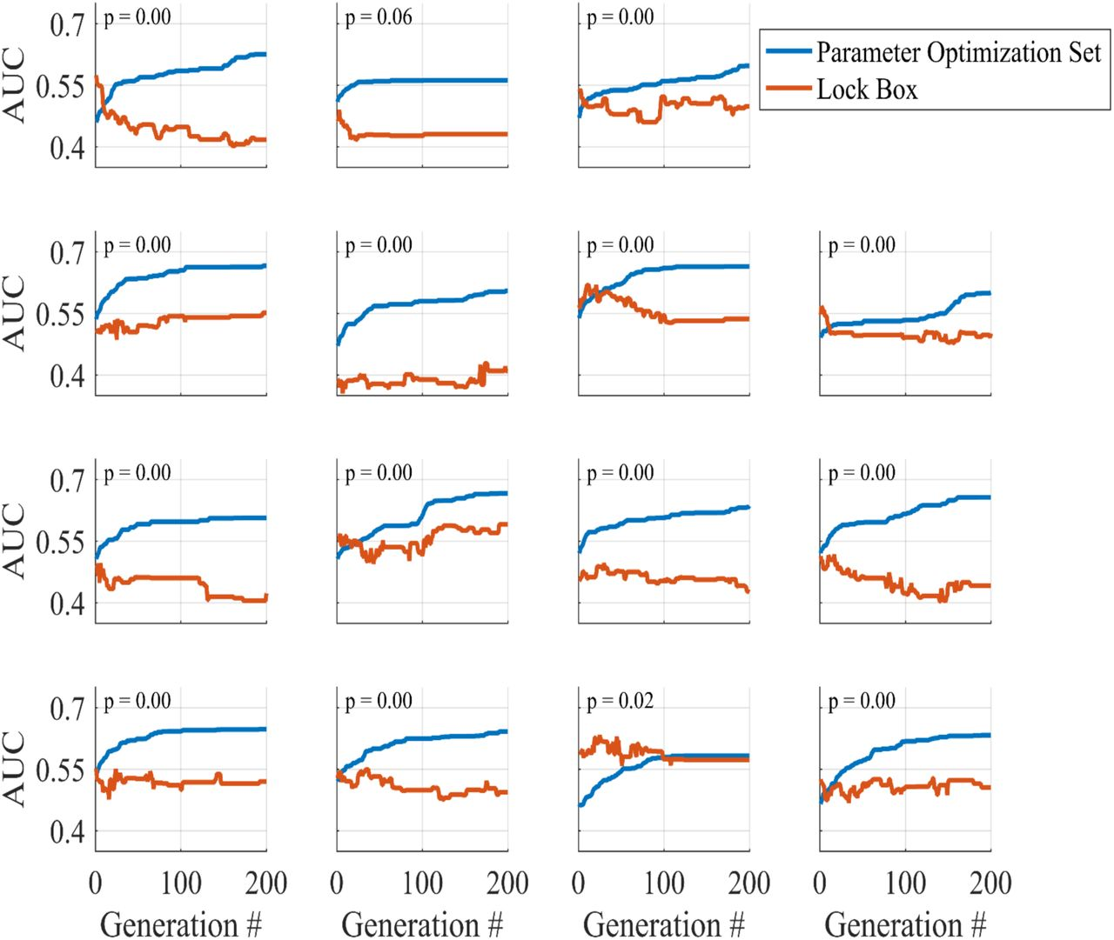

Slide 16
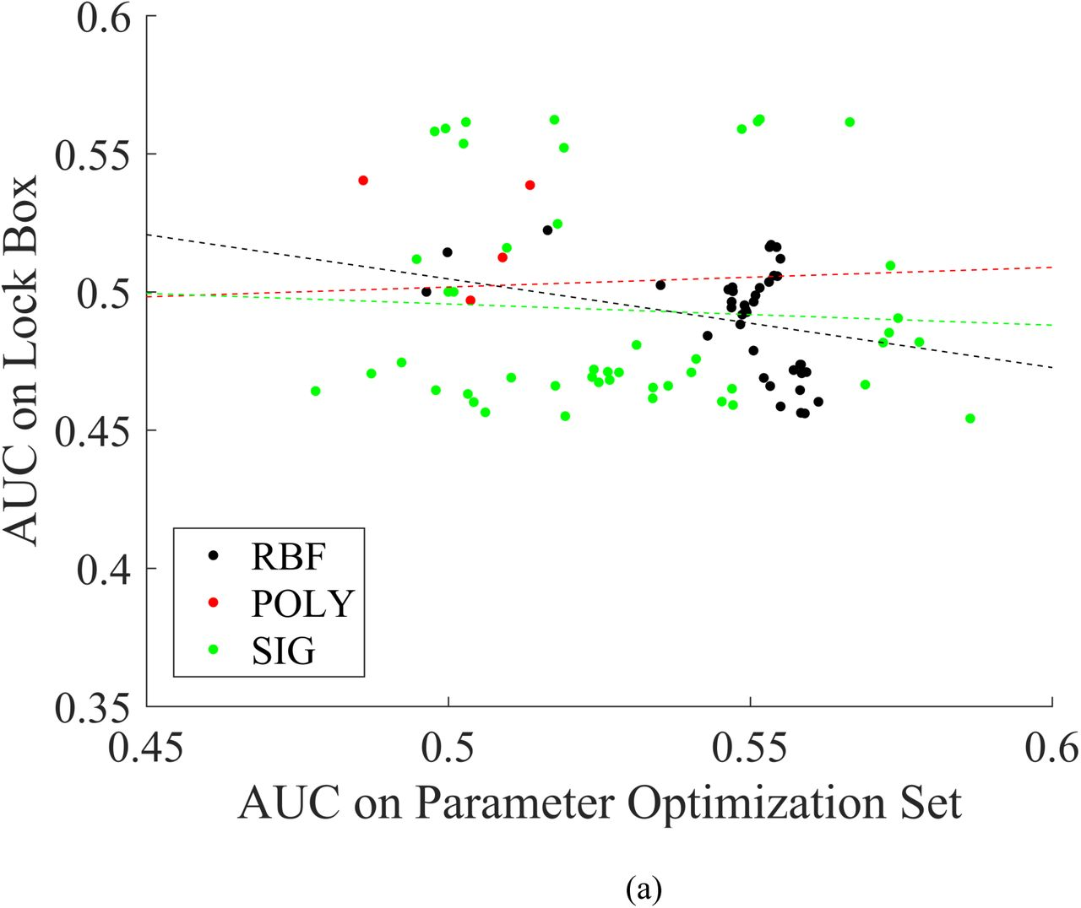
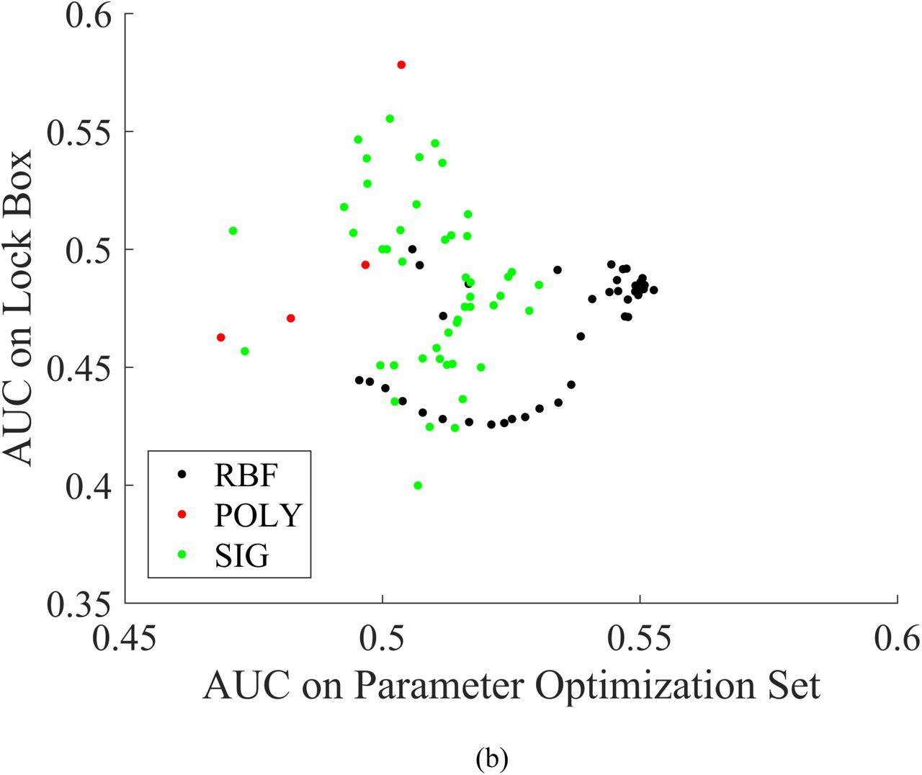

Slide 17
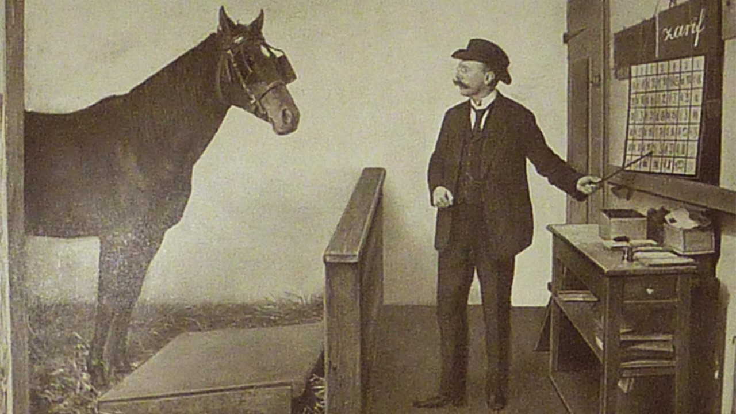

Slide 18
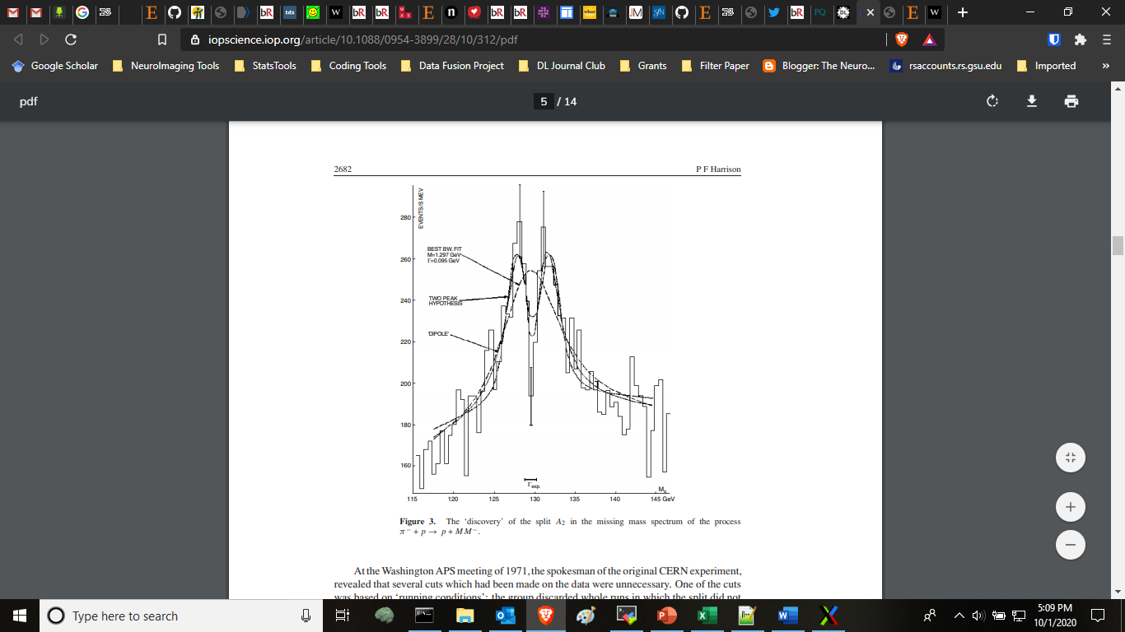
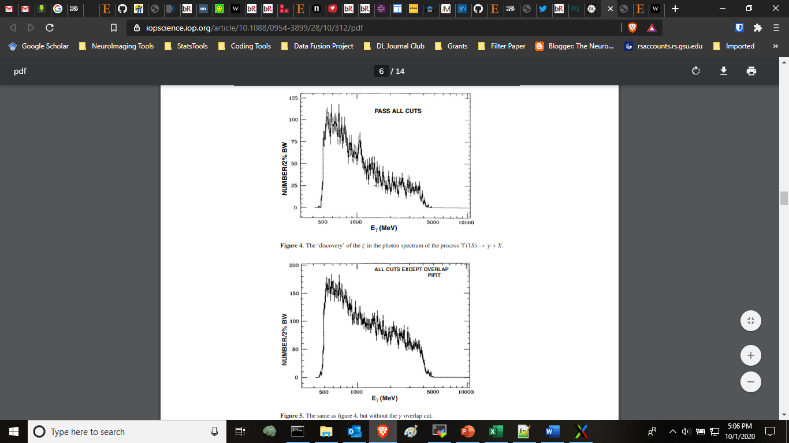
Chikovani, G., M. N. Focacci, W. Kienzle, C. Lechanoine, B. Levrat, B. Maglić, M. Martin et al. "Evidence for a two-peak structure in the A2 meson." Physics Letters B 25, no. 1 (1967): 44-47.

Slide 19

The Blind Analysis Approach
A blind analysis is an analysis in which the final result and the individual data on which it is based, are kept hidden from the analyst until the analysis is essentially complete
Some examples include:
Scrambling all condition labels
Adding some amount of noise to all signals (e.g. artificially increasing the amplitude of the P300 in one condition)
Artificially adding ‘target signals’ to trials
Harrison, P. F. "Blind analysis." Journal of Physics G: Nuclear and Particle Physics 28, no. 10 (2002): 2679.
Klein, Joshua R., and Aaron Roodman. "Blind analysis in nuclear and particle physics." Annu. Rev. Nucl. Part. Sci. 55 (2005): 141-163.

Slide 20
3
7

Slide 21
7
3

Slide 22
?
?

Slide 23
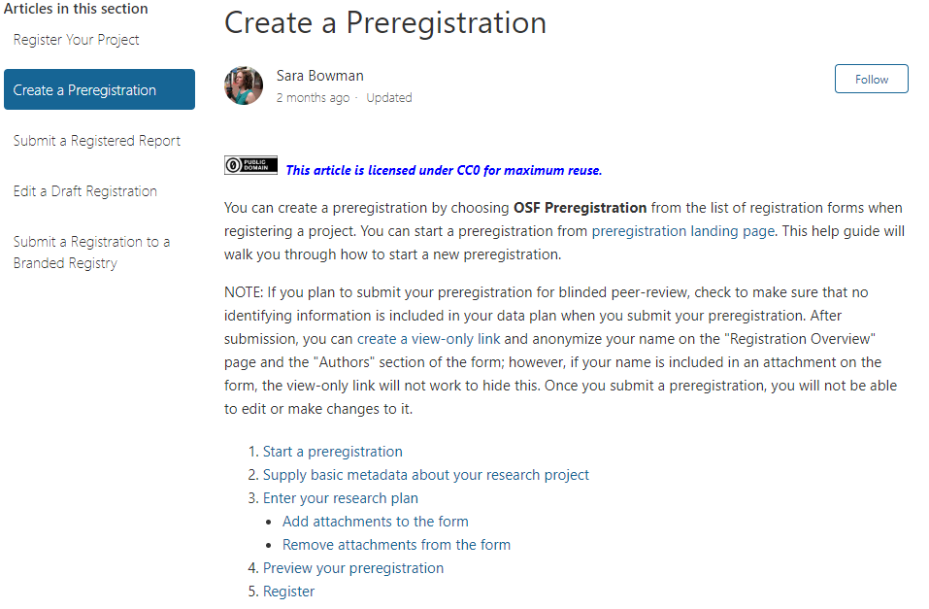
Preregistration
The idea:
You establish your hyper-parameters/analyses before hand (in a public manner), run them, then publish the output.
The Problem:
There’s next to no optimization or tuning.
“You get what you get.”

Slide 24

Preregistration
The idea:
You establish your hyper-parameters/analyses before hand (in a public manner), run them, then publish the output.
The Problem:
There’s next to no optimization or tuning.
“You get what you get.”

Slide 25
Discussion Topics:
Under what conditions could we pre-register an analysis or classifier?
What are some examples of experimenter bias that could lead to the “hyper-fitting” described by the authors?
In a world where data is expensive and hard to come by, how could samples be “lock-boxed,” or how would we facilitate pre-processing of such data?
What on earth are we fitting if we’re blind to the events in the timeseries or the diagnostic categories?

